Slide 1
HCD: Discovery Phase Iteration
October 10, 2019
Facilitated by: Ross Speir and Kyle Maddox
Human Factors Engineering (HFE)
Office of Health Informatics (OHI) (10P2)
Veterans Health Administration (VHA)

Slide 2
Agenda
Field Site Findings in the HCD information structure
Next Steps
Proposed Project Timeline
Questions

Slide 3
HCD information structure
Key Points
Enables a shared vision
Design goals
User needs and intended usage
Reflects gaps in our current understanding
‘Minimally sufficient information’
Informs the usability evaluation
Next actions
Information reviewed for accuracy (Dr. Bradshaw)
Design objectives prioritized (Dr. Crowe)
Demo the HCD information structure

Slide 4
Line of site to MVP definition
Desirability
Useful, Usable, Support workflow
Viability
Clinical impact, Support MHPO initiatives
Feasibility
Technical capabilities, Data quality, Implementation plan
The MVP is the intersection of…

Slide 5
Line of site to MVP definition
Objective: Produce a minimally viable product intended for implementation at legacy sites.
Core Team
Business Office
VAMC Pilot Sites
Technical SMEs
MVP Deliverables
Working prototypes developed and assessed by end users at pilot sites
Intended outcomes / value measures
Draft Evaluation and Implementation plans
Backlog of unmet user and stakeholder needs

Slide 6
Project Timeline (Notional)
Rapid Prototyping (Nashville)
Prototype Eval (Palo Alto)
Prototype Eval (Houston)
Prototype Eval
(Boston)
MVP defined
Pilot Testing
(TVHS, Palo Alto,?)
Oct
Nov
Dec
Jan
Feb
Mar

Slide 7
Next Steps for Defining MVP
Recruit Additional Team Members:
Add Elliott, Mental Health Informaticist (has MH dashboard)
CACs from field sites: TVHS, Palo Alto, Houston, Boston
To help us create CPRS piece of application, helps with buy-in from field site
Introduction to My HealtheVet Patient Generated Data Team
Possible solution for gathering PROM data from Veterans
Host a face-to-face with the team @ IRDC Nashville
Ideate, storyboard and rapid prototype a solution
Identify barriers and knowledge gaps
Plan site visits for prototype evaluation @ Palo Alto, Houston, Boston
Validate user needs, specify context of use variation at VAMCs

Slide 8
Questions?

Slide 9
For More Information
Study Series Lead(s):
Kyle Maddox (VHA OHI HFE, Kyle.Maddox@va.gov) Ross Speir, (VHA OHI HFE, Ross.Speir@va.gov)
HFE Points of Contact:
Kurt Ruark, HFE Acting Director (Kurt.Ruark@va.gov)
9

Slide 10
TVHS Site Visit Purpose
‘User research’ into needs, motivations, pain points and behaviors of intended Ptool users.
Allows team to:
1) Build empathy among team members and stakeholders in relation to the users and customers, and what they need; and
2) Uncover insights that will help the project team design and improve the application experience, and uncover insights that can lead directly to innovative opportunities, features, and/or product improvements.
Allow HFE to learn about the subject matter, read previously conducted research and familiarize ourselves with the nature of psychotherapy interventions.
Objectives:
Identify various user roles, workflows and tools
Identify typical patient cases and ‘edge case’ examples
Determine user needs

Slide 11
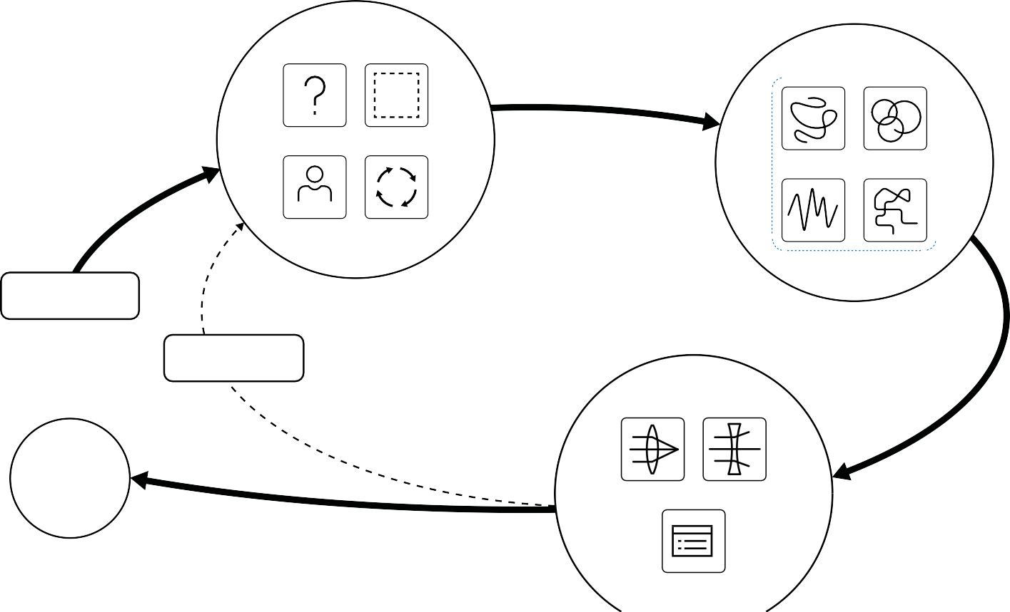
8
Human-Centered Design: Discovery Stage Field Guide
Introduction / Research Cycle
9
Step 1: Project Brief
The project brief is the initial ask, expressed interest, or situation to study. This can come from leadership, one of your partners, or from your own experience or inquiry.
Read more about Project Briefs on pages 10-11.
Step 4: Plan your research logistics
With your participants lined up, plan out the rest of the research logistics. Reserve a space, gather the tools, draft questions, and establish roles for the team. Read more about planning on pages 10-11 and 14-15.
Discovery Cycle
Step 2: Create a frame of inquiry
A frame of inquiry, or the “How Might We” question, identifies and frames the issue or the situation you are exploring. Use the “How Might We...” prompt to frame your area of inquiry. Read more about framing and HMW questions on pages 10-11.
Step 5: Do the research
As the participants move through your frame of inquiry in their own way, remember that their perceptions and approaches are valid reflections of their reality. That is what you want to understand. Read more about doing the research on pages 16-19.
BEFORE
DURING
Step 3: Recruit research participants
Work within your network (both inside and outside of your agency) to find participants who meet your criteria. Look closely for participants whose life circumstances and experiences align with your frame of inquiry. Read more about recruiting on pages 10-11.
1 . BRIEF
2 . FRAME
PARTICIPANTS
3 . RECRUIT
4 . PL AN
Step 6: Synthesis
Synthesis happens after your team has finished the interviews. Now, all members of your team come together and collectively review and analyze the information you’ve gathered. Now is the time to step back, take stock, and tease out common themes and patterns.
Read more about synthesis on pages 20-21.
START
Step 9: Reframe (if needed)
Often, after your first round of research and synthesis, you realize how much you didn’t know about what you didn’t know.
Step 7: Opportunities
Insights will emerge during synthesis. The best and most relevant ideas, quotes, and observations, will rise to the top. These can become fields of opportunity to explore.
Read more about Insights on pages 22-25.
REFRAME
Though it may not feel like progress, it is. Sometimes, at this stage, you also decide to adjust your “How might we…” question to one that more accurately captures your findings in this initial phase of research. You may also decide to engage in additional rounds of research.
AF TER
DESIGN PHASE
SYNTHESIS
OPPORTUNITIES
Step 8: Present
Now is the time to communicate your findings to stakeholders and leadership. Know your audience and tailor your presentation accordingly. Read more about presenting on pages 26-27.
Once your team has completed the research, synthesized the results, presented it, and have support to move forward, then the next step in the Human-Centered Design process is Design.
PRESENT

